Slide 1



Design and Implementation of a Database Management System for Sports Club Membership and Tournament Management
TEAM MEMBERS
Likhith Ram — 25WU0101038
Sai Samhith — 25WU0101008
Vidhathreya — 25WU0101040
Woxsen University — School of Technology
B.Tech CSE | CSE – Tigers
PostgreSQL Relational Database Project

Slide 2






Design and Implementation of a Database Management System for Sports Club Membership and Tournament Management
The Problem
  Sports clubs manage large amounts of member, payment, team and tournament data.
  Manual or disconnected records can cause duplicate and inconsistent information.
  Facility and tournament scheduling can lead to conflicts.
  Equipment borrowing and returns are difficult to track accurately.
Objectives
Intended Users
  Centralize all sports club data.
  Manage memberships and payments efficiently.
  Manage teams, coaches, tournaments and facilities.
  Maintain accurate and consistent records.
Club Administrators
Manage memberships, payments and policies.
Sports Coordinators
Manage tournaments, teams and fixtures.
Club Staff
Manage members, coaching and equipment.

Slide 3
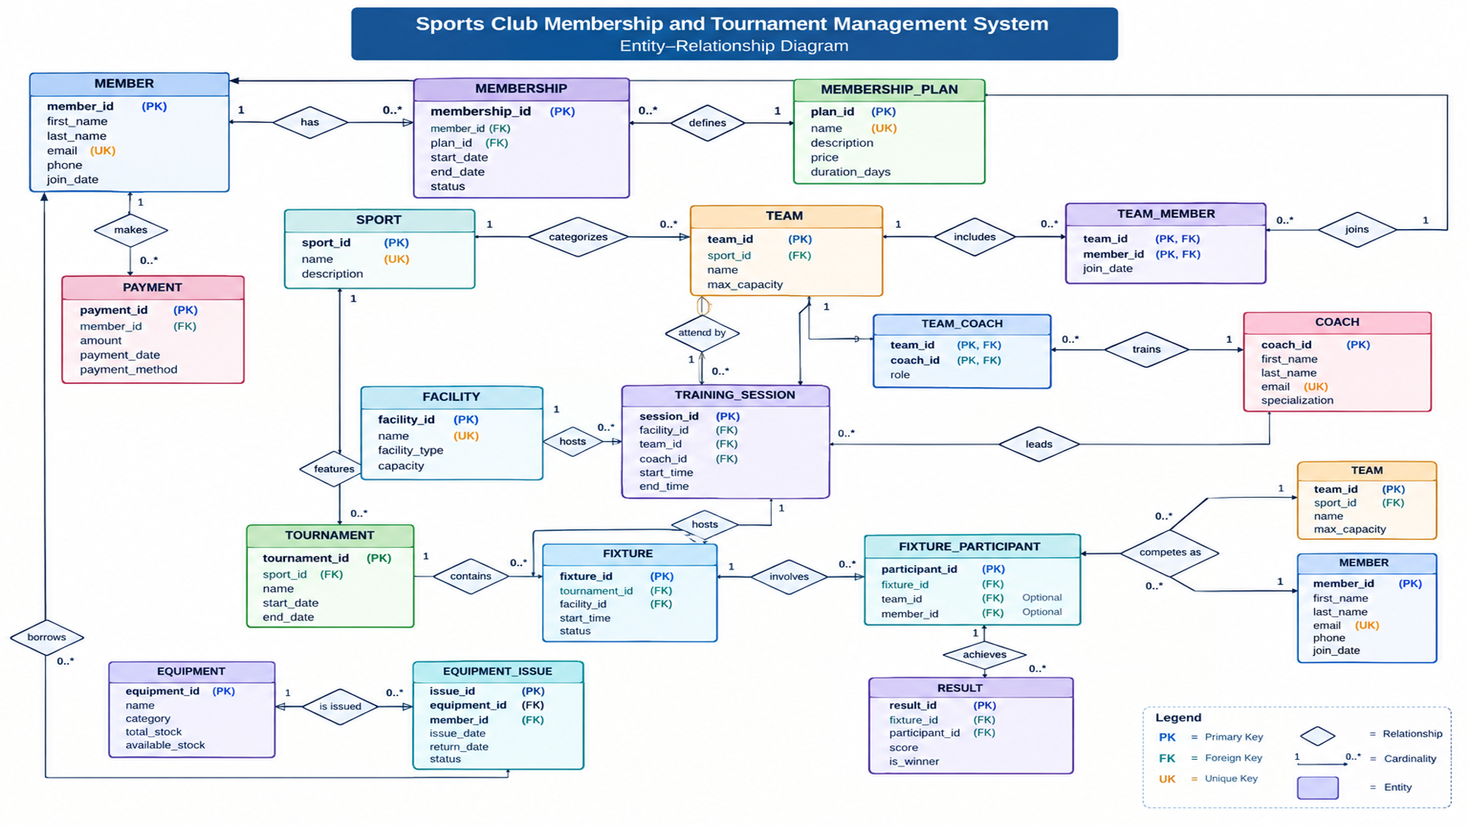


Slide 4
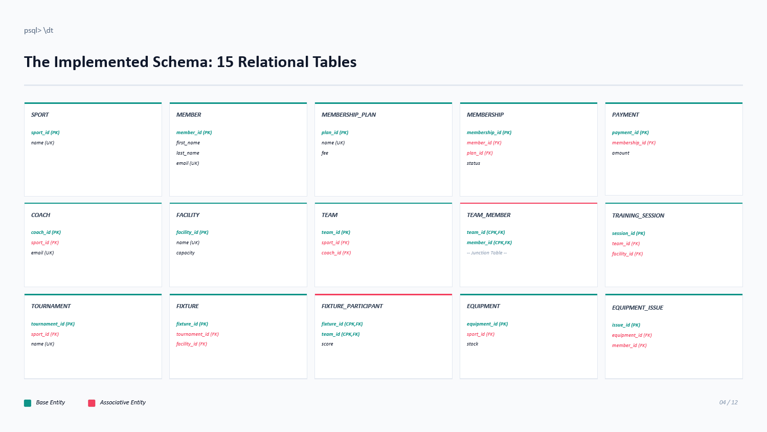

Slide 5
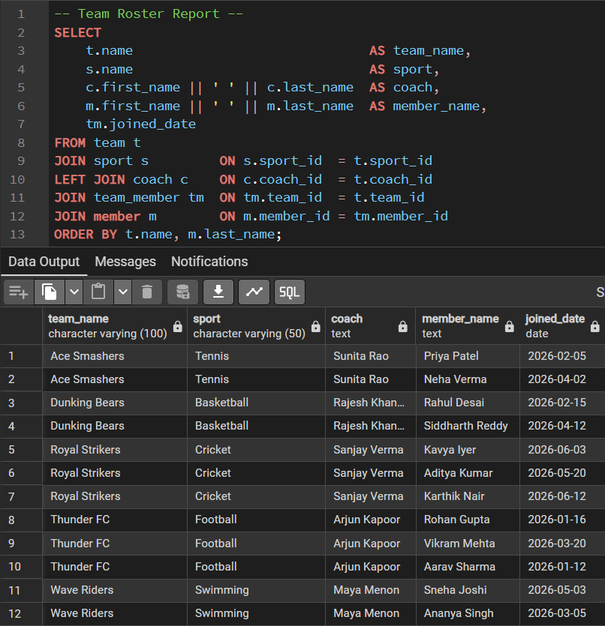
Filled-In Tables — Real Query Output
Sample rows loaded with INSERT statements, then confirmed with SELECT * — actual captured output
What each clause does
SELECT
Chooses the information to display, including team, sport, coach, member
and the date the member joined the team.
FROM team t
Starts with the TEAM table, which is the main entity for this report.
JOIN sport s
Connects each team to its sport using sport_id, allowing the sport name to be displayed.
LEFT JOIN coach c
Adds the assigned coach information while still keeping the team even if a coach
is not assigned.
JOIN team_member tm
Connects teams with their members through the TEAM_MEMBER junction table.
JOIN member m
Retrieves the member's personal information from the MEMBER table.
ORDER BY
Sorts the result first by team name and then by member surname,
making the roster easier to read.
Result
The query produces a complete team roster showing:
Team → Sport → Coach → Member → Joined Date

Slide 6
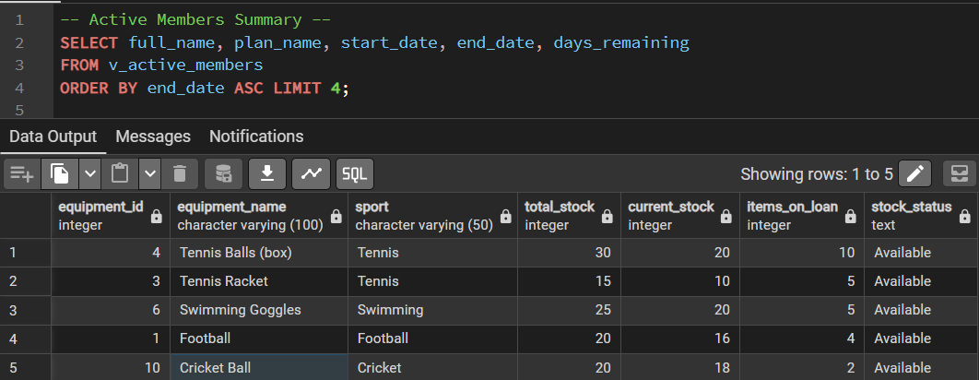
Query Execution — Active Membership Summary
SELECT
Selects the member name, membership plan, start date, end date, and remaining membership days.
FROM v_active_members
Reads the required information from the v_active_members view containing active membership records.
ORDER BY end_date ASC
Sorts memberships by expiry date, with the earliest-ending memberships shown first.
LIMIT 4
Restricts the report to the first four records.

